Slide 1
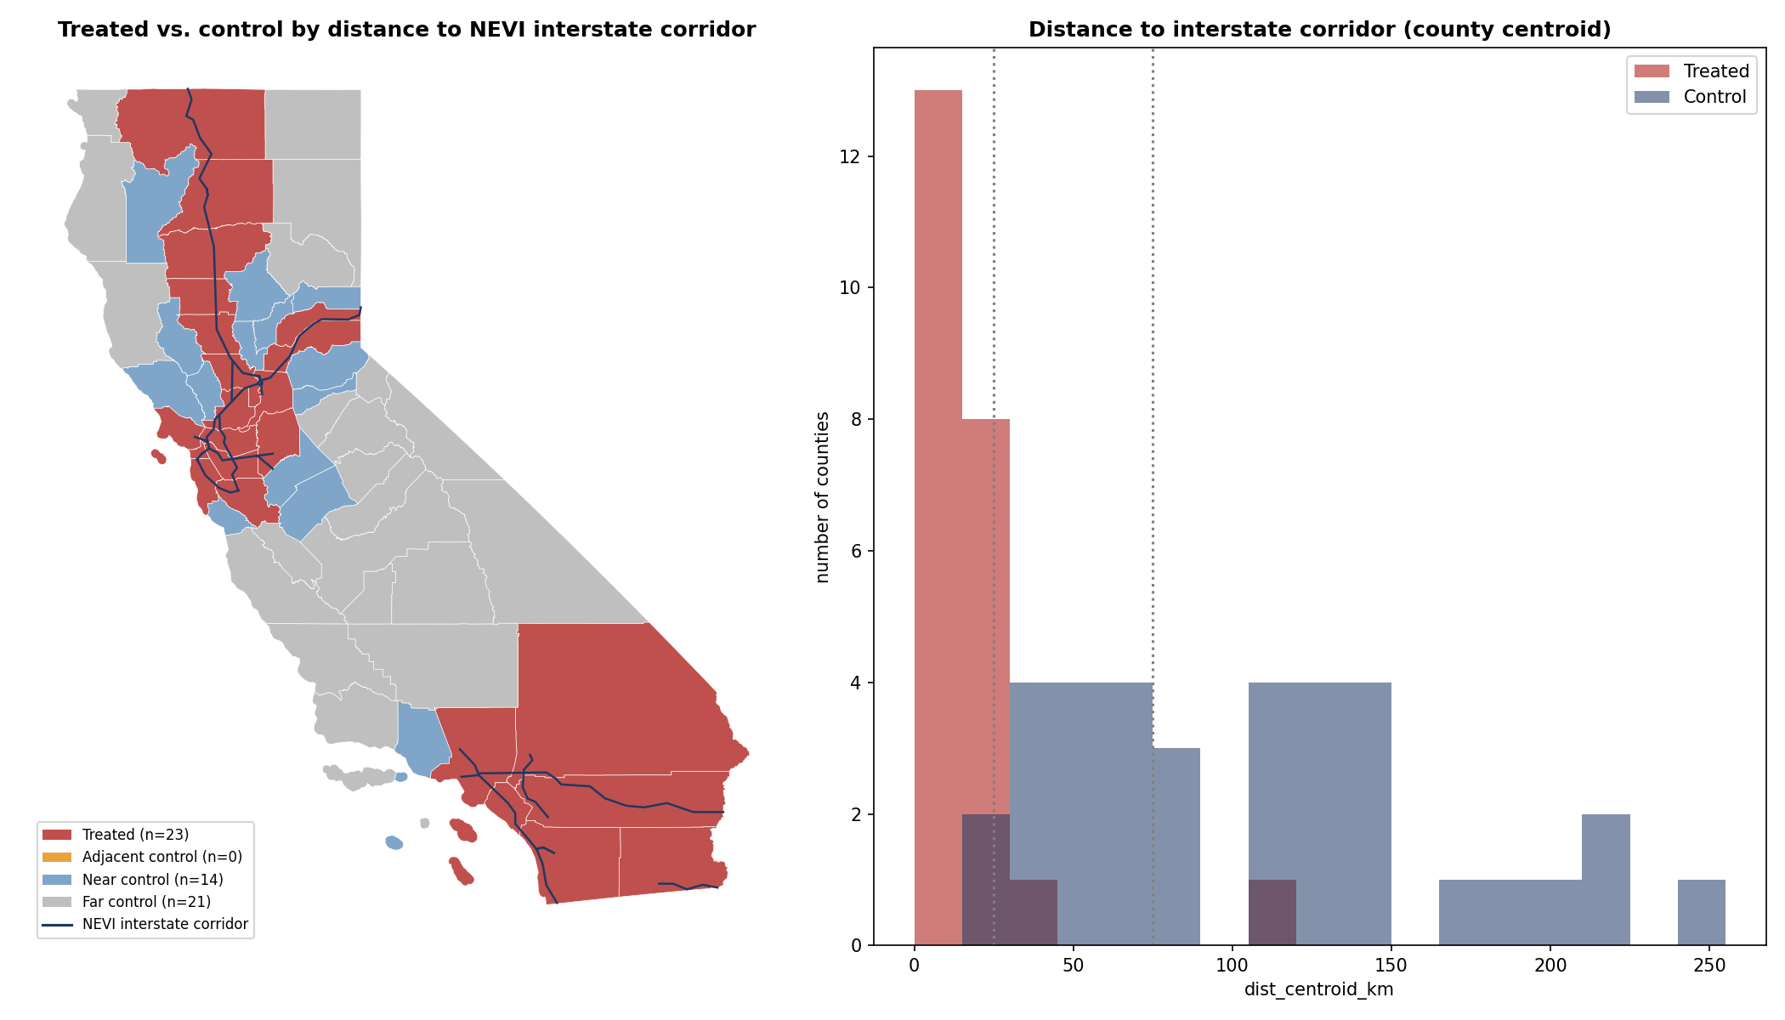
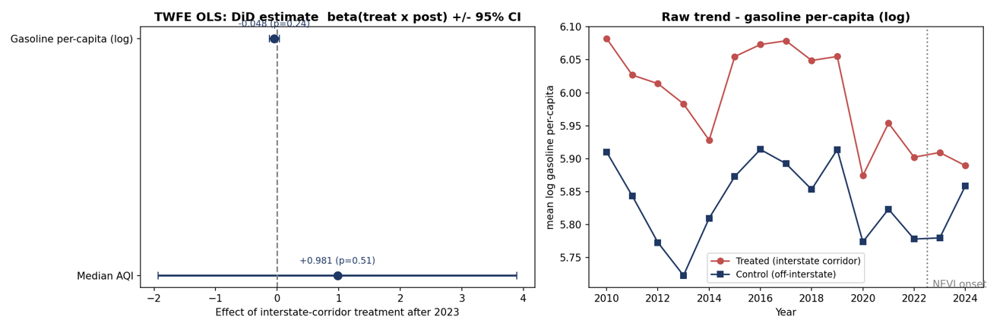
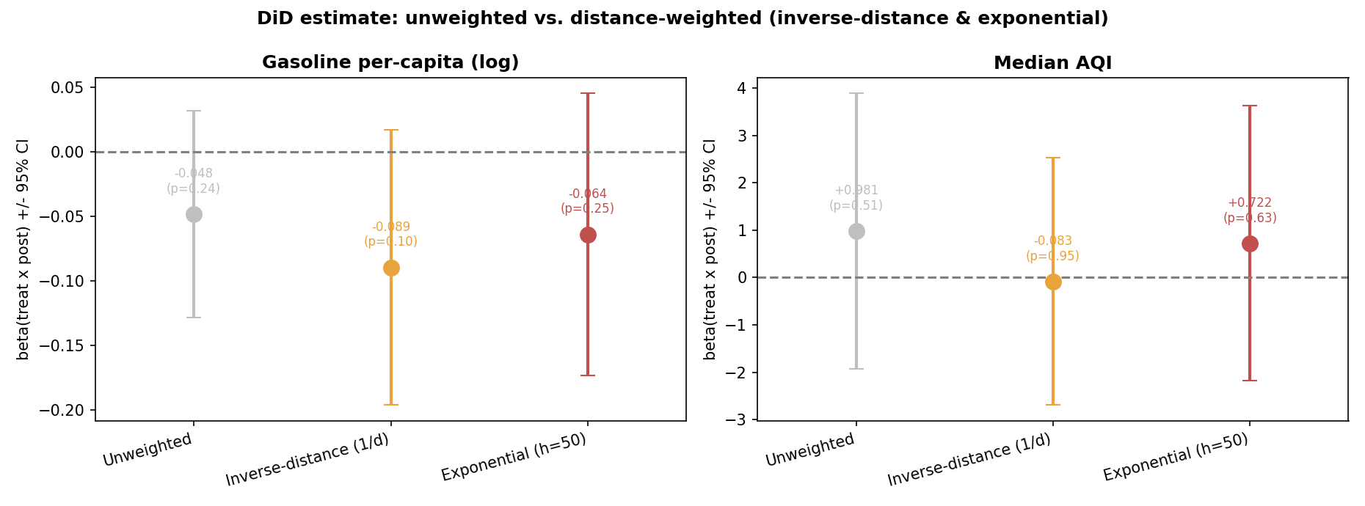
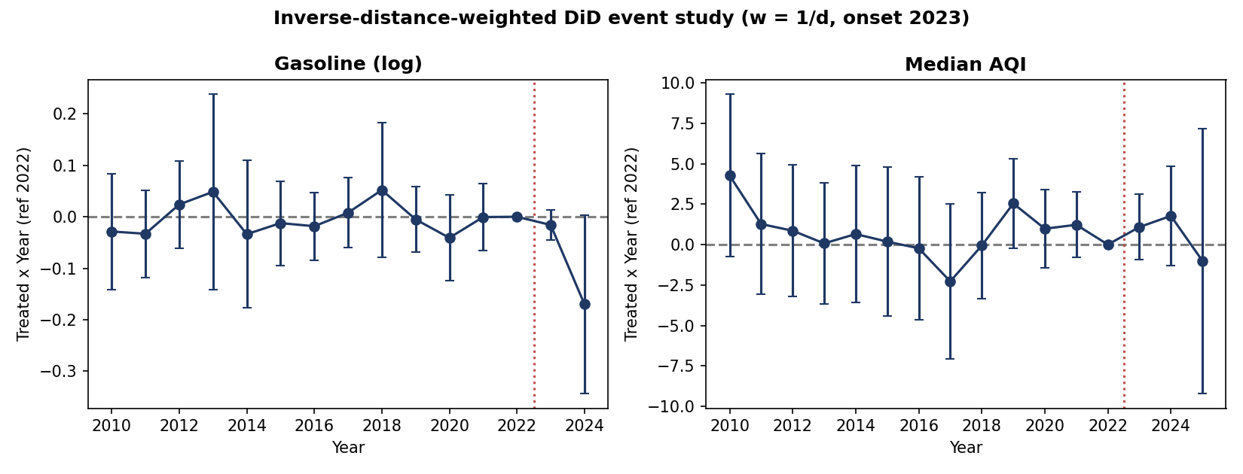
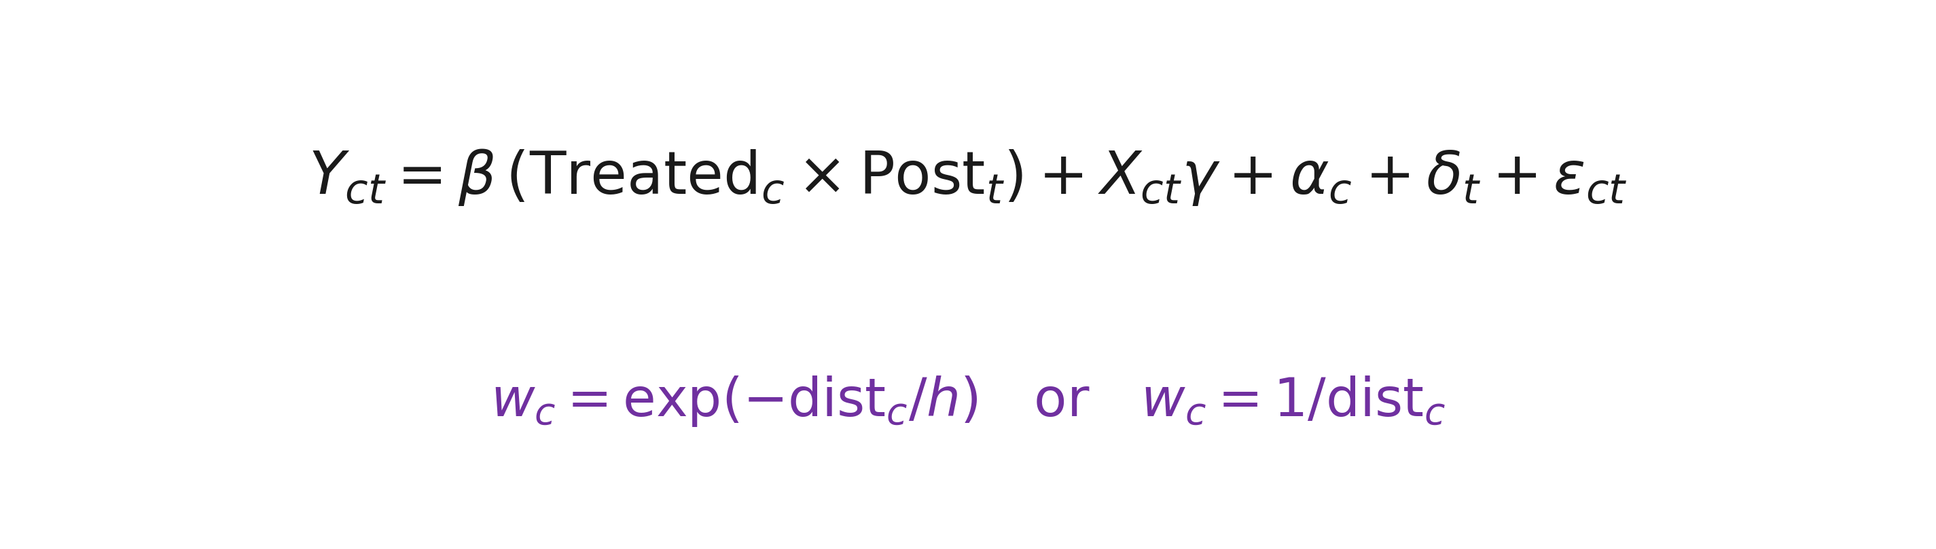
Charging the Corridors: A Distance-Weighted Difference-in-Differences Analysis of NEVI Interstate Fast Charging Deployment, Gasoline Consumption, and Air Quality across California Counties
Khoi Van
Department: Economics
Research Advisor: Dr. John Conzelmann
Introduction
By 2023 California recorded ~1.26 million light-duty EV registrations and by late 2025 surpassed 200,000 public chargers, yet gasoline use has not fallen proportionally and transportation remains the state’s largest source of greenhouse gas emissions.
The 2022 National Electric Vehicle Infrastructure (NEVI) Formula Program directs federal funds to build DC fast-charging along designated Interstate Alternative-Fuel Corridors before any other spending.
Because corridor placement is fixed by the federal interstate network and state-administered rather than chosen by counties, it offers a plausibly exogenous shock.
Research question: did the NEVI corridor build-out reduce per-capita gasoline consumption and improve local air quality in the counties it crosses, relative to comparable off-corridor counties?
Results
Conclusion
For gasoline the effect is negative and grows stronger as weight concentrates on corridor-adjacent counties (−0.048 → −0.089), with an event-study estimate of ≈ −0.17 by 2024.
This is suggestive evidence that fuel displacement is concentrated near the state-built charging corridors — where a proximity mechanism predicts — while stopping short of conventional significance.
Median AQI shows no detectable corridor effect over this short window.
Main limitation: a short post-treatment window (gasoline observed only through 2024), so estimates are directional. Next steps: continuous-dose / staggered DiD and causal machine learning as more post-2023 data are collected.
Figure 1: Treated versus control counties by distance to the NEVI interstate corridor (left) and the distribution of county-centroid distances (right).
Acknowledgements
The Lisska Center for Intellectual Engagement, Denison University.
Department of Economics, Denison University.
Dr. John Conzelmann, Department of Economics, Denison University.
Methodology
Balanced California county-year panel: 58 counties, 2010–2025 (928 county-years) from the CEC, U.S. DOE AFDC, EPA AQS, Census ACS, and the state NEVI corridor GIS layer.
Treatment: 23 corridor (treated) counties vs. 35 off-corridor (control), onset 2023; a county is treated if an interstate corridor crosses it ≥ 5 km.
Two-way fixed-effects DiD (county + year FE), controlling for log median household income and share driving alone; SEs clustered by county.
Distance-weighted DiD weights each county by centroid distance to the corridor — an exponential-decay kernel (h = 50 km) and inverse-distance (1/d) — concentrating identification near the threshold; event studies trace dynamics.
Two outcomes: log per-capita gasoline and median Air Quality Index (AQI):
References
• Callaway, B., & Sant'Anna, P. H. C. (2021). Difference-in-differences with multiple time periods. Journal of Econometrics, 225(2), 200–230.
• Callaway, B., Goodman-Bacon, A., & Sant'Anna, P. H. C. (2024). Difference-in-differences with a continuous treatment.
• Federal Highway Administration. (2023). National Electric Vehicle Infrastructure Formula Program Final Rule (23 CFR Part 680).
• Bushnell, J. B., Muehlegger, E., & Rapson, D. S. (2022). Energy prices and electric vehicle adoption (NBER Working Paper 29842).
• Van, K. (2025). Driving change: Assessing the impact of EV charging infrastructure on gasoline consumption across California counties.
Figure 2: Baseline TWFE DiD estimate (left) and raw treated-vs-control gasoline trend (right).
Figure 3: DiD under unweighted, inverse-distance, and exponential (h = 50 km) weighting.
Key Findings
• Baseline DiD on log gasoline is −0.048 (p = 0.24); tilting weight toward corridor-adjacent counties makes it progressively more negative — −0.064 (exponential, h = 50 km) and −0.089 (inverse-distance, p = 0.10), roughly double the unweighted effect.
• Bandwidth surface: the gasoline effect strengthens smoothly from −0.048 (h = 250 km) to −0.130 (h = 15 km) — the more identification concentrates on corridor-adjacent counties, the larger the estimated fuel reduction.
• Event study: flat, near-zero pre-trends, then the gasoline effect turns negative after the 2023 onset and reaches −0.17 by 2024 (p = 0.055).
• No control county lies within 25 km of the corridor; treated counties (mean ≈ 17 km) are separated from the nearest controls by a visible gap — exactly the spatial structure distance weighting exploits.
• Median AQI shows no detectable effect under any weighting scheme over this short window.
Figure 4: Inverse-distance-weighted DiD event study (reference 2022, onset 2023).

